Slide 3
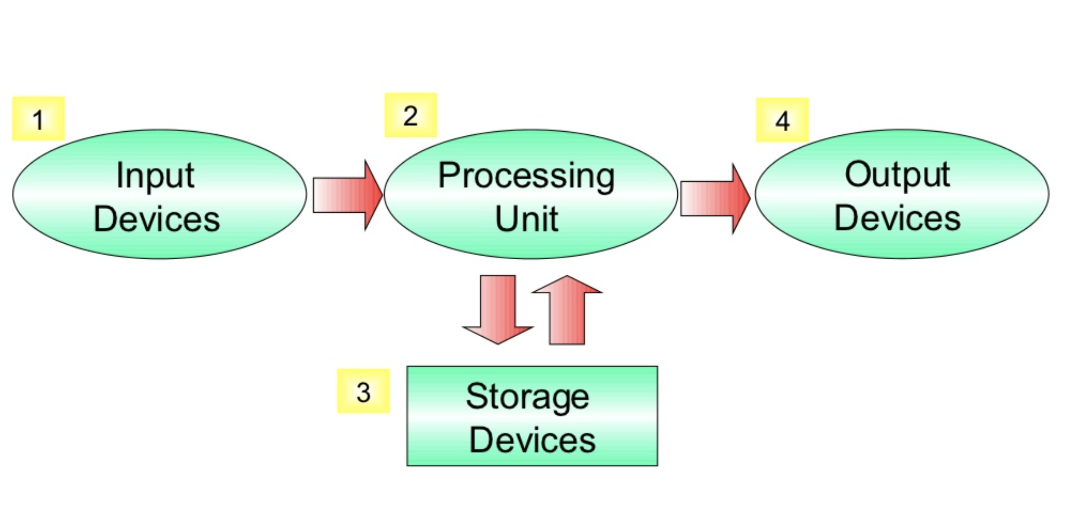

Slide 5

CENTRAL PROCESSING UNIT (CPU)

Slide 6
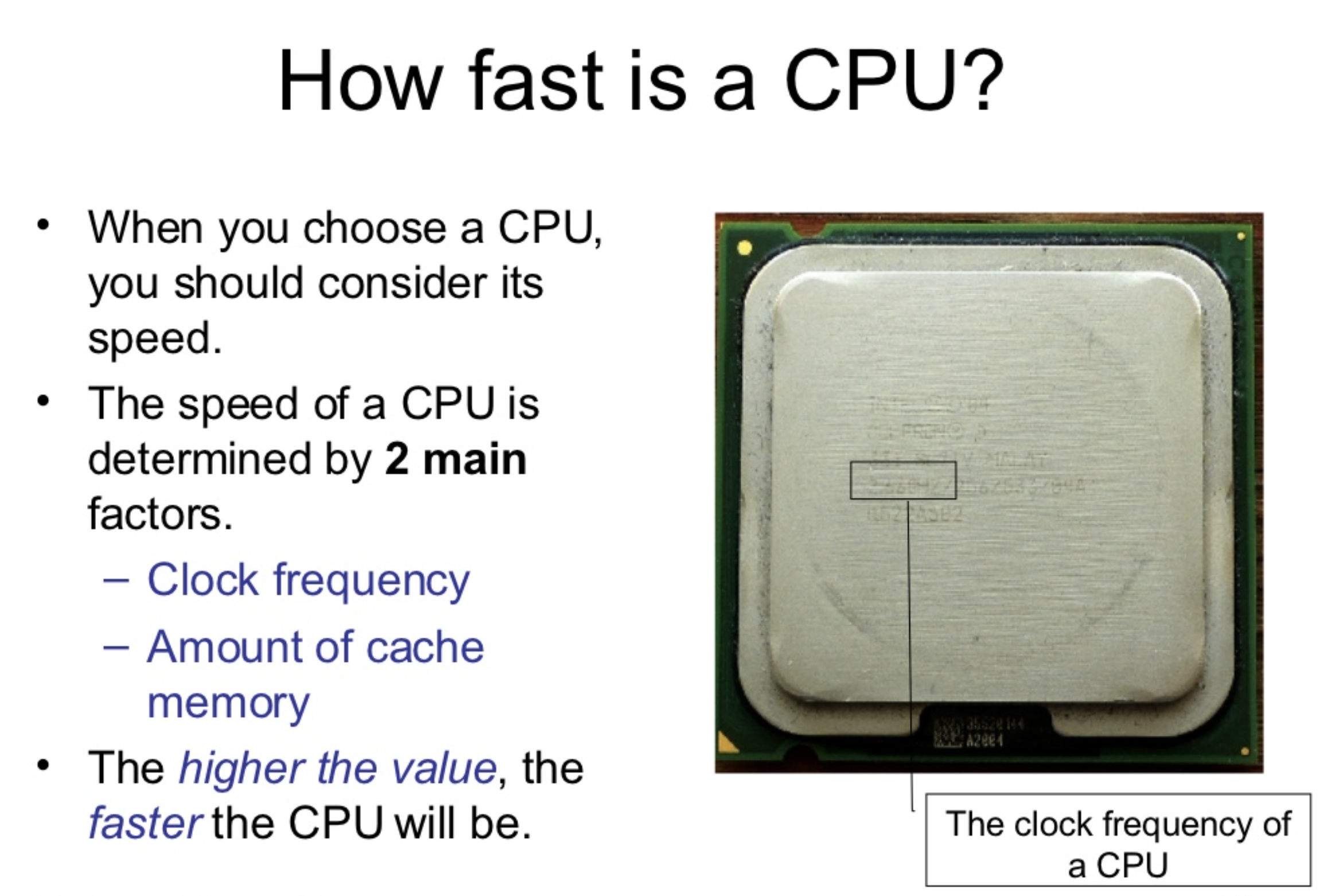
Measured in Hz (GHz)

Slide 7
RAM

Slide 8
STORAGE
Measured in bytes (MB, GB)

Slide 9
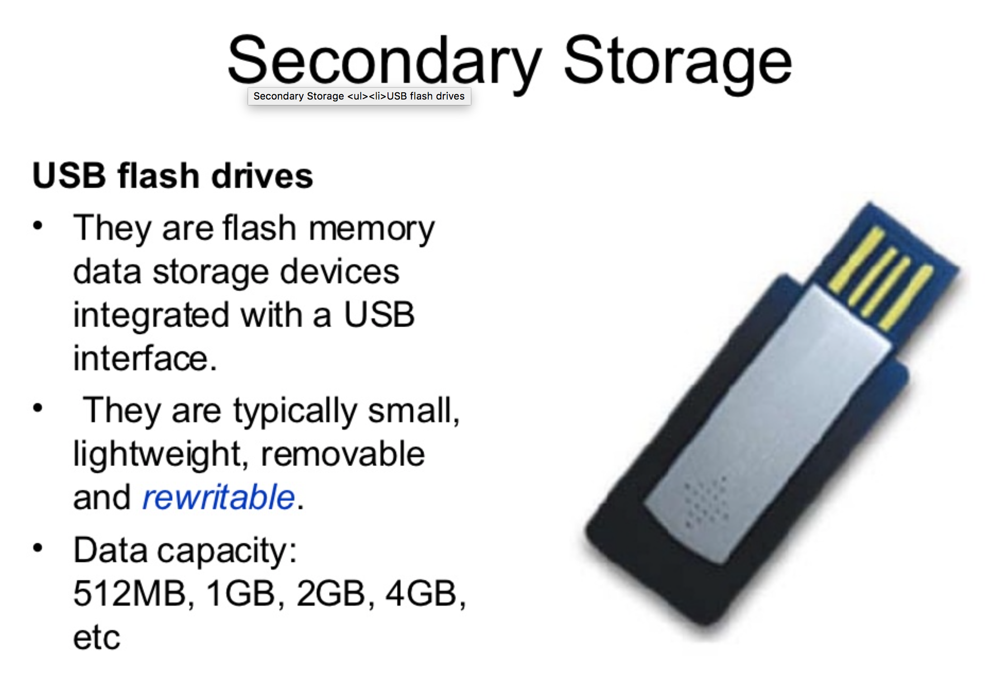

Slide 10
MOTHERBOARD

Slide 11
PORTS

Slide 12
EXPANSION CARDS

Slide 13
POWER SUPPLY
HEATSINK / FAN

